Slide 1





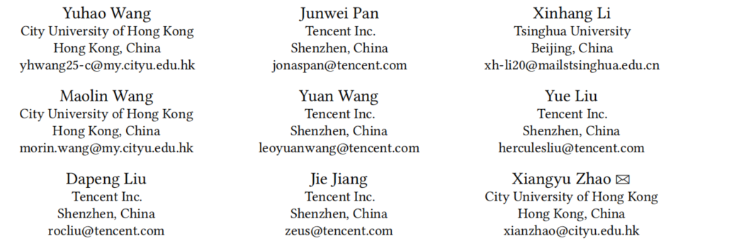





ATAI
Advanced Techniqueof Artificial Intelligence
ATAI
ChongqingUniversity _{AdvancedTechniqueof}
of Technology Artificial Intelligence
Chongqing University of
Technology
Chongqing University ^{ATAI}
_{of Technology} Advanced Techniqueof
Artificial Intelligence
Chongqing University of Technology
Chongqing University of Technology
Empowering Large Language Model for Sequential
Recommendation via Multimodal Embeddings and Semantic IDs
Code: https://github.com/Applied-Machine-Learning-Lab/MME-SID
2025.10.24•ChongQing
CIKM_2025
Reported by Jing Li
1

Slide 2

ATAI
AdvancedTechniqueof
Artificial Intelligence
ATAI
ChongqingUniversity _{AdvancedTechniqueof}
of Technology Artificial Intelligence
ChongqingUniversity of Technology
Motivation
1. The existing sequence recommends that the large model relies on a single collaborative information. When the low-dimensional pre-training is embedded and mapped to the high-dimensional LLM space, the matrix rank is low and the information is compressed, resulting in the not fully utilized expression ability of the model.
2. After quantifying the semantic ID generated by RQ-VAE, discard the code embedding and retraining only with semantic ID, resulting distance information loss.

Slide 3

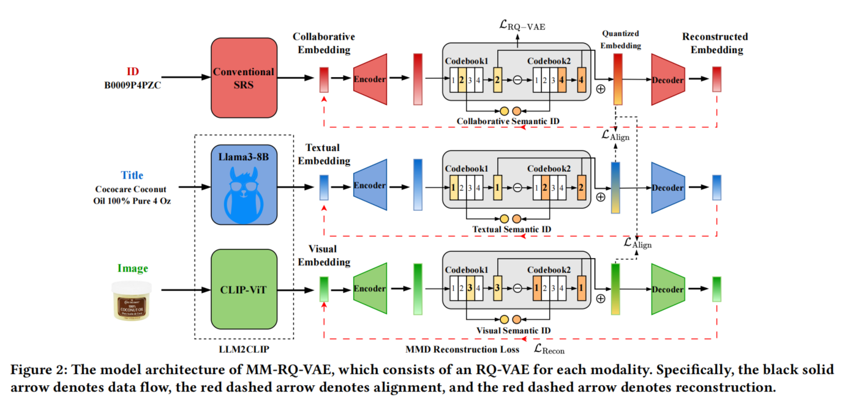
ChongqingUniversity of Technology
ATAI
AdvancedTechniqueof
Artificial Intelligence
ATAI
ChongqingUniversity _{AdvancedTechniqueof}
of Technology Artificial Intelligence
Overview

Slide 4
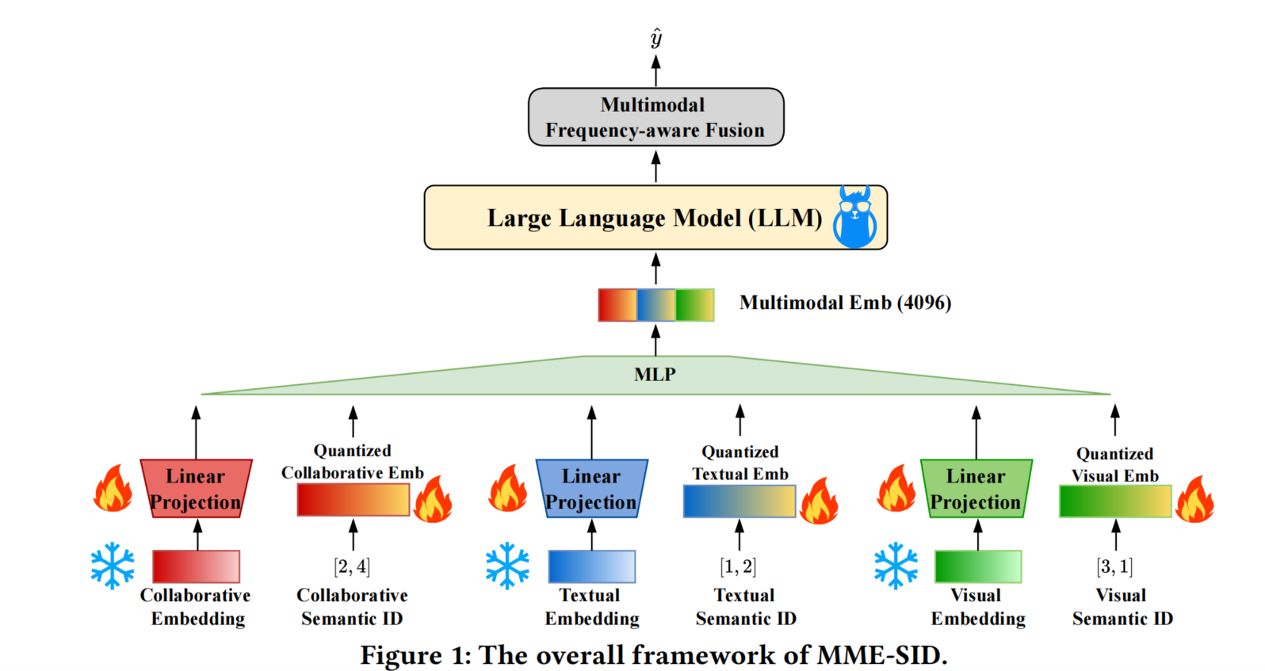
ChongqingUniversity of Technology
ATAI
AdvancedTechniqueof
Artificial Intelligence
ATAI
ChongqingUniversity _{AdvancedTechniqueof}
of Technology Artificial Intelligence
Overview

Slide 5

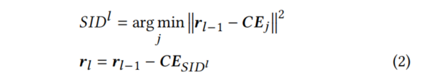
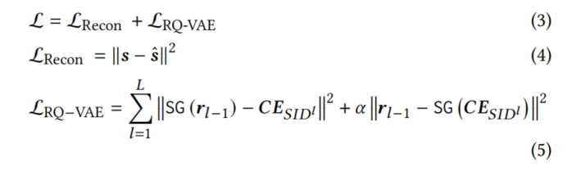
ChongqingUniversity of Technology
ATAI
AdvancedTechniqueof
Artificial Intelligence
ATAI
ChongqingUniversity _{AdvancedTechniqueof}
of Technology Artificial Intelligence
Method

Slide 6

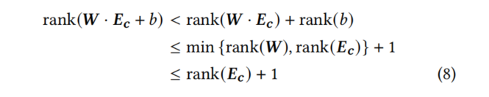

ChongqingUniversity of Technology
ATAI
AdvancedTechniqueof
Artificial Intelligence
ATAI
ChongqingUniversity _{AdvancedTechniqueof}
of Technology Artificial Intelligence
Method

Slide 7
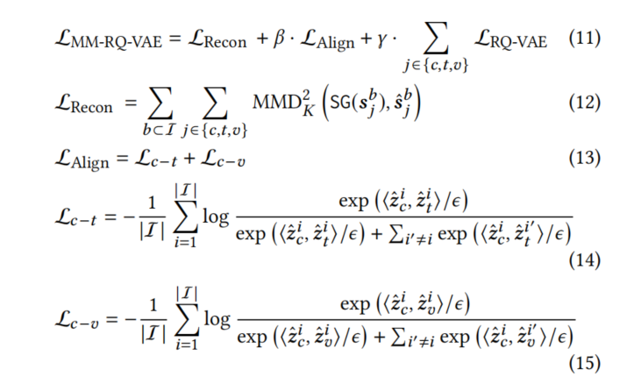
ChongqingUniversity of Technology
ATAI
AdvancedTechniqueof
Artificial Intelligence
ATAI
ChongqingUniversity _{AdvancedTechniqueof}
of Technology Artificial Intelligence
Method

Slide 8
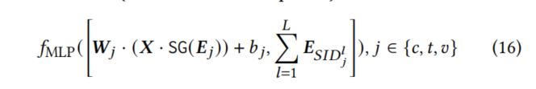

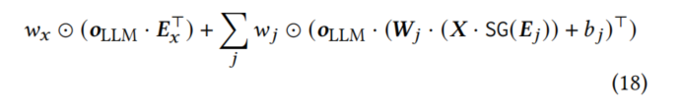
ChongqingUniversity of Technology
ATAI
AdvancedTechniqueof
Artificial Intelligence
ATAI
ChongqingUniversity _{AdvancedTechniqueof}
of Technology Artificial Intelligence
Method

Slide 9

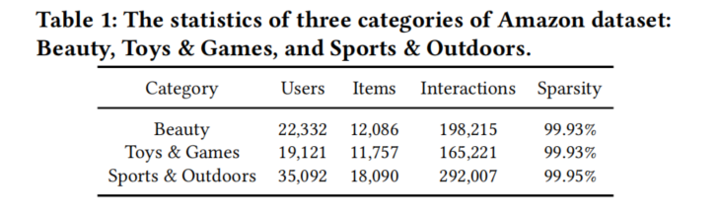
ATAI
AdvancedTechniqueof
Artificial Intelligence
ATAI
ChongqingUniversity _{AdvancedTechniqueof}
of Technology Artificial Intelligence
ChongqingUniversity of Technology
Experiments

Slide 10
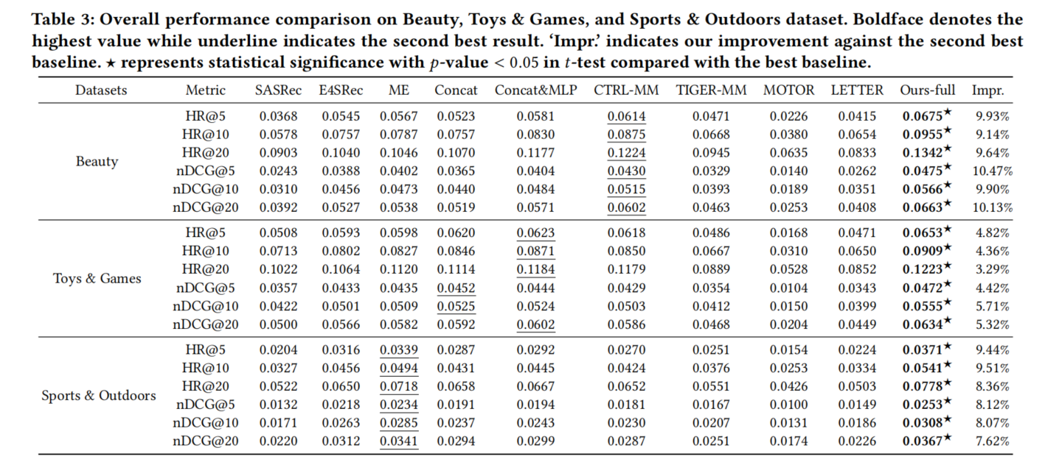
ATAI
AdvancedTechniqueof
Artificial Intelligence
ATAI
ChongqingUniversity _{AdvancedTechniqueof}
of Technology Artificial Intelligence
ChongqingUniversity of Technology
Experiments

Slide 11
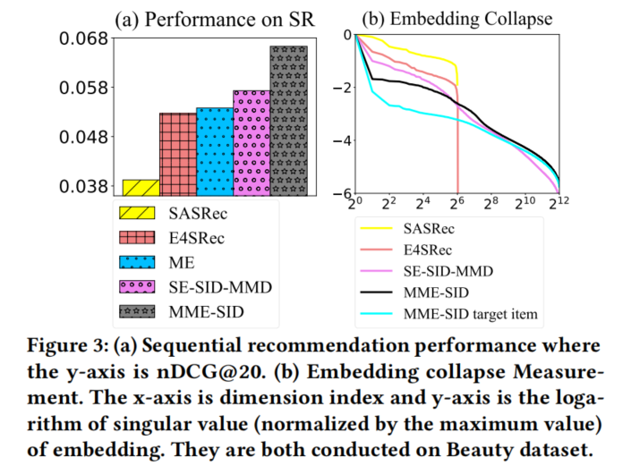
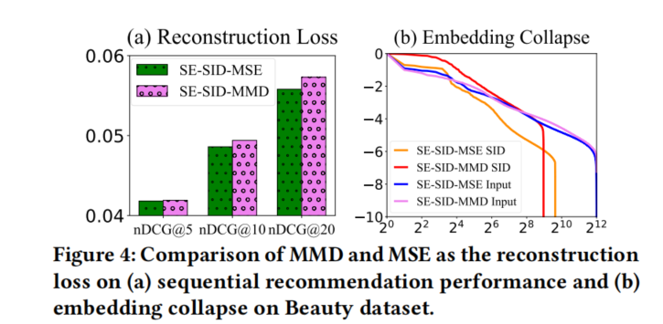
ATAI
AdvancedTechniqueof
Artificial Intelligence
ATAI
ChongqingUniversity _{AdvancedTechniqueof}
of Technology Artificial Intelligence
ChongqingUniversity of Technology
Experiments

Slide 12
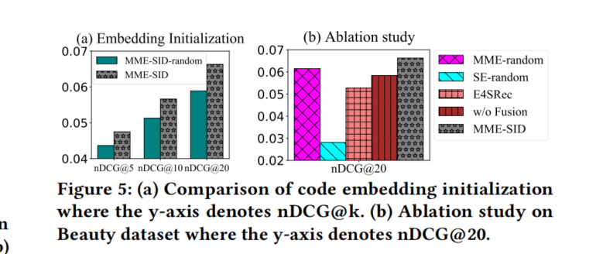
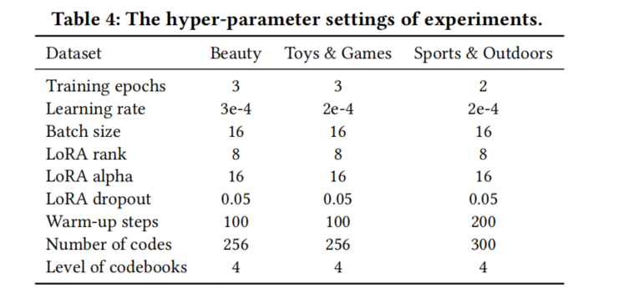
ATAI
AdvancedTechniqueof
Artificial Intelligence
ATAI
ChongqingUniversity _{AdvancedTechniqueof}
of Technology Artificial Intelligence
ChongqingUniversity of Technology
Experiments

Slide 13


ChongqingUniversity of Technology
ATAI
AdvancedTechniqueof
Artificial Intelligence
ATAI
ChongqingUniversity _{AdvancedTechniqueof}
of Technology Artificial Intelligence
Thanks!

